Slide 1

A happy life
By: Tannya Singh and Selvi Chhabra

Slide 2
Starters on being successful
Success- one’s achievements or the favorable outcome of something expected.
You should always work hard and never give up. By putting in effort, then you will accomplish your task no matter how hard it is.
Never lose faith in God. God will help you during stressful times especially if your having difficulty in accomplishing your short or long term goal.
Always stay determined. Determination is a very important quality that will allow you to achieve anything. Keep dreaming and achieving.

Slide 3
Being successful continued…
Have courageous qualities in you, never let anyone put you down. If your family or friends stop you from doing something you love, just move on and look past the setbacks. Don’t give up on your dreams.
Try to maintain good relationships with your peers at your work or school. Your friends will help you through hard times.
Always be calm during difficult situations. The situation will only become worse when we start to panic, which will lead you to nowhere.

Slide 4


The Results of these Tips
Impersonal Excellence- When you strive to achieve something, you will win in the end.
Material Prosperity- As you become more successful in life, you will have more things.
Emotional Maturity- Along with all these things will come responsibilities. You will understand your surroundings and your purpose.
Spiritual Growth- Attaining success cannot happen without the blessings of God. By praying daily, you will also mature spiritually. But make sure to wish for the well-being of others as well, since you don’t want to be selfish.

Slide 5

Time scheduling
Time management is a problem that most people have a tough time to overcome. Here are some ways to allow yourself to save time:
Review what you learned in school daily so you don’t have to worry about studying at the last minute.
Finish your projects ahead of time.
Make a planner full of events you need to do
Have a limited amount of free time, especially if you have an exam the next day
Stay organized so you don’t lose important materials or things you need the next day

Slide 6

Why is time management a key to success?
People who use time managing skills tend to be more successful than others.
You’ll become less stressful, if you plan your time wisely.
Time managing will allow you to make a better decisions than ones that are made in a rush.
If you finish all of your work early, then you will have more free time in your hands.
Controlling your time will allow you to submit high quality work. After all, it’s all about quality not quantity.

Slide 7
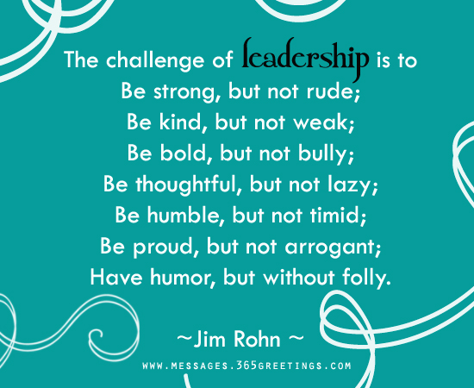

How can you become a leader?
In order to become a leader you need to:
Consider everyone’s opinions.
Give everyone the respect that they deserve.
Stay determined and never give up.
Stand up for other people that are supporting you who are in trouble.
Mahatma Gandhi was a leader who had considered everyone’s viewpoints and had fought for what was right.

Slide 8


For students and employees
“Whatever the person does that is also followed by others; what standard he demonstrates through action, the people will follow.” This quote is mentioned in the Gita. It means that leaders will be followed by their followers. If they demonstrate something bad, then a very bad situation will arise since even more people would follow it as well. Leadership is always good for students and employees. In school, kids should answer questions and be the first one to hand in homework. By setting a good example in class, others will follow in your steps. At work, people should build relationships and set goals. By building relationships, people will have trust and confidence in you, be it to complete a project on time or to schedule appointments. Setting goals simply doesn’t mean you have to achieve them, but it can also be used as a standard to which tasks are expected of you.

Slide 9



Being a leader in our own lives
When we both grow up, we want to become doctors. In order to achieve our long term goal, we must always work hard and get good grades. But getting good grades isn’t everything. We also should be putting in effort. All of our assignments should be qualitative. In addition, we have to stay determined so that we can conquer anything that can possibly come in our way. We need to be determined and motivated to fulfill our goal and ultimately achieve our earned success. We need to set a good example for other kids who also want to join this work field.

Slide 10
A successful lifestyle
Have a positive attitude toward everyone. This will help you create a positive mindset inside yourself.
Stay away from evil deeds and bad friends. These friends will influence you and cause you to do bad things just like them.
Always be devoted in God. If you are struggling at one point in your life, god will surely be there to help you.
Try to achieve your goal one step at a time. At the end when your goal is reached, you will feel complete since you’ve accomplished a big phase in your life.

Slide 11





